Slide 1
ITO peak detection
Ge Gao

Slide 2
Data processing
Totally there are 2792 TIF images over 50 seconds. And they have been converted to a 3D array.
Transform this 3D array into polar coordinates with a ring width of 1 pixel and the radius range is from 0 to 500 pixels. Then take the mean intensity value of the ring located on the same radii.
Finally take mean value of the radius intensity with respect to time.
Evenly select 10%, 20% of images for future analysis.
10% -> 279 imgs
20% -> 558 imgs
100% -> 2792 imgs
Notes:
2nd transformation takes the longest time. Previously woodie choose the ring width to be 2. this time I used 1 for better precision.

Slide 3
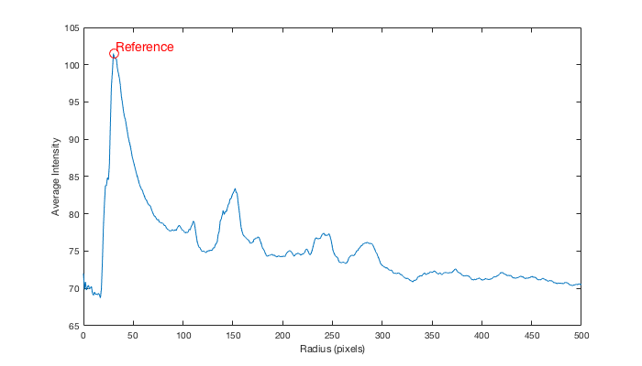
Reference peak and possible peak locations
All local maxima are found using MATLAB built-in function findpeak()
The highest peak is the reference peak to find other peak locations from Crystal Maker Simulation.

Slide 4
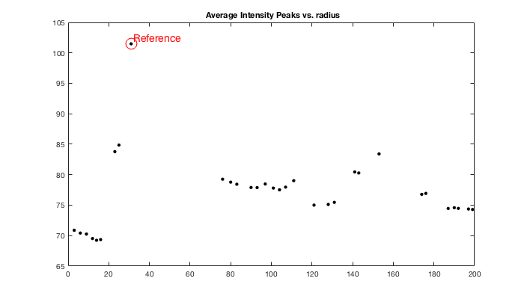
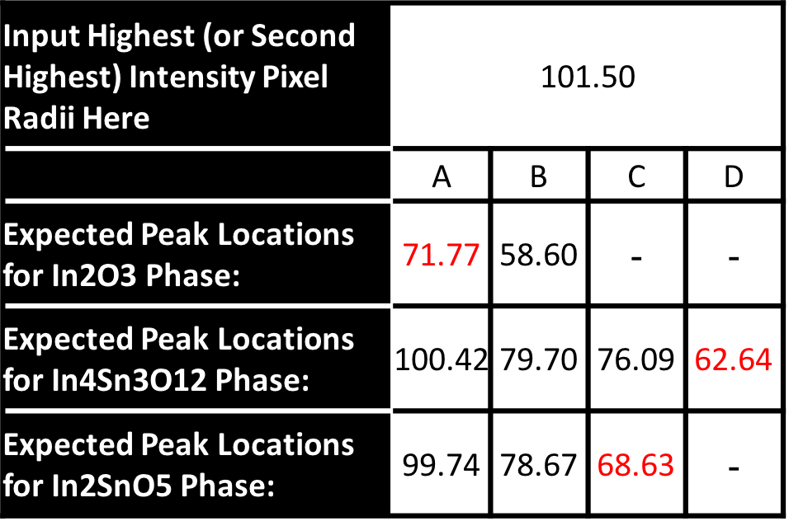
Peak detection
We only focus on radius range from 0 to 200 pixels.
10% -> 93 peaks
20% -> 84 peaks
100% ->87 peaks
Notes:
Red texts are distinct locations that should be easy to find based on crystal maker. 10% and 20% has a highest and second highest peak. This one is 100 data with only 1 highest peak

Slide 5
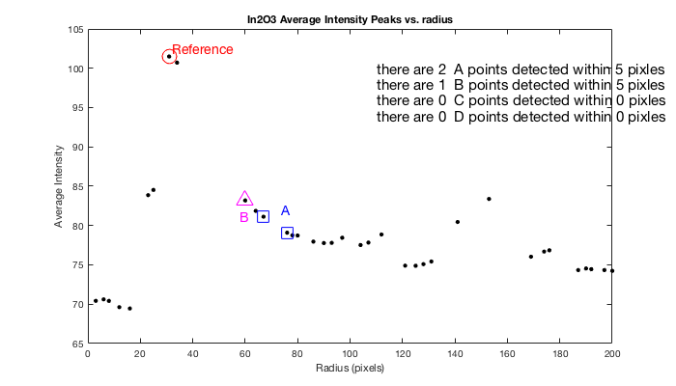
In₂O₃ 10% DATA
Manually set up the tolerance for the individual peak detection and slowly increase the tolerance till we find at least one peak within our expected location.
 | A | B | C | D
Expected Peak Locations for In2O3 Phase: | 71.77 | 58.60 | - | -
Experimental locations | 67,76 | 60 | - | -
# detected | 2 | 1 | - | -
% error | 7.34 | 2.39 | - | -
Notes:
A should be obvious to find. But there are two experimental locations. Under 5, no peak A at all.

Slide 6
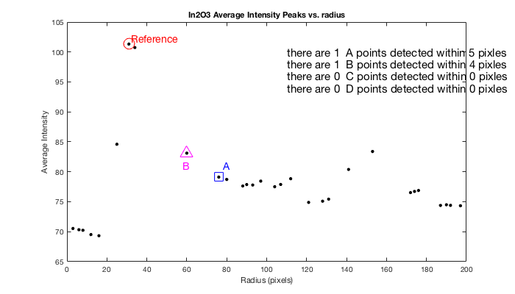
In₂O₃ 20% DATA
 | A | B | C | D
Expected Peak Locations for In2O3 Phase: | 71.77 | 58.60 | - | -
Experimental locations | 76 | 60 | - | -
# detected | 1 | 1 | - | -
% error | 5.89 | 2.38 | - | -
Notes:
With 20% taken into consideration, only 1 point A is found this time. And still we have two reference peaks

Slide 7
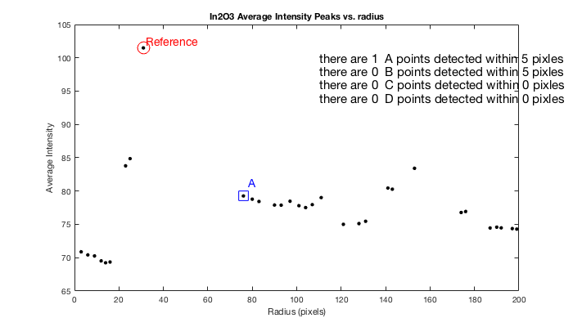
In₂O₃ 100% DATA
 | A | B | C | D
Expected Peak Locations for In2O3 Phase: | 71.77 | 58.60 | - | -
Experimental locations | 76 | - | - | -
# detected | 1 | 0 | - | -
% error | 5.89 | 100 | - | -
B is missing
Notes:
After average the whole data, peak B vanished.

Slide 8
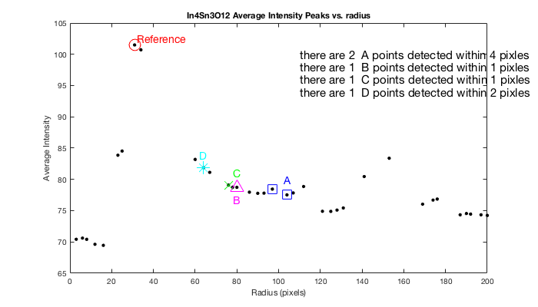
In₄Sn₃O₁₂ 10% DATA
 | A | B | C | D
Expected Peak Locations for In4Sn3O12 Phase: | 100.42 | 79.70 | 76.09 | 62.64
Experimental locations | 97,104 | 80 | 76 | 64
# detected | 2 | 1 | 1 | 1
% error | 3.5 | 0.37 | 0.11 | 2.17
Notes:
With only 10% data considered, these 4 peaks fit very well.

Slide 9
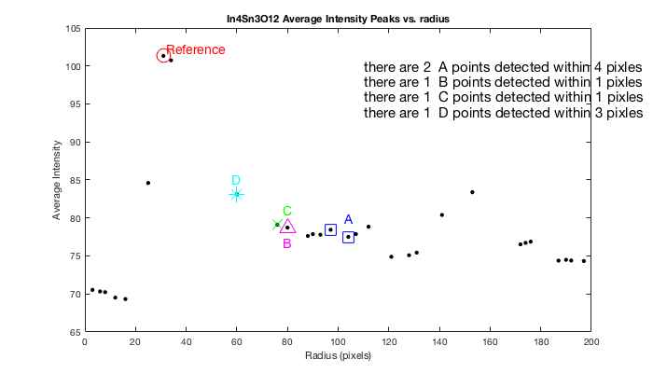
In₄Sn₃O₁₂ 20% DATA
 | A | B | C | D
Expected Peak Locations for In4Sn3O12 Phase: | 100.42 | 79.70 | 76.09 | 62.64
Experimental locations | 97,104 | 80 | 76 | 60
# detected | 2 | 1 | 1 | 1
% error | 3.49 | 0.37 | 0.12 | 4.12
Notes:
All peaks are found again.

Slide 10
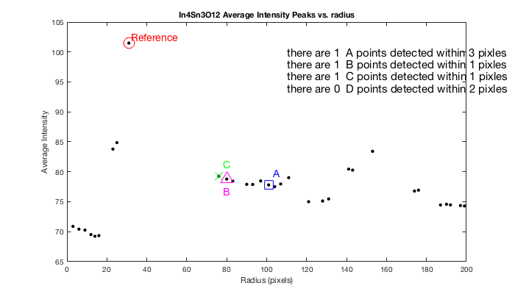
In₄Sn₃O₁₂ 100% DATA
 | A | B | C | D
Expected Peak Locations for In4Sn3O12 Phase: | 100.42 | 79.70 | 76.09 | 62.64
Experimental locations | 101 | 80 | 76 | -
# detected | 1 | 1 | 1 | 0
% error | 0.58 | 0.38 | 0.12 | 100
D is lost
Notes:
It seems that when all the data is taken into consideration, peaks around 60 vanishes and it’s hard to be detected. Is this because of the phase difference of the diffraction image?

Slide 11

In₂SnO₅ 10% DATA
 | A | B | C | D
Expected Peak Locations for In2SnO5 Phase: | 99.74 | 78.67 | 68.63 | -
Experimental locations | 97 | 78 | 67 | -
# detected | 1 | 1 | 1 | -
% error | 2.82 | 0.85 | 2.37 | -
Notes:
Both of 43 12 and 125 fit with our desired location. And 43 12 has relatively lower % error.

Slide 12

In₂SnO₅ 20% DATA
 | A | B | C | D
Expected Peak Locations for In2SnO5 Phase: | 99.74 | 78.67 | 68.63 | -
Experimental locations | 97 | 80 | 76
# detected | 2 | 1 | 1 | -
% error | 2.75 | 1.69 | 10.74 | -
Notes:
Peak C is found with high deviation and when experimental B and C are very close to each other. These two points can be treated as peak B location too if we increase the tolerance of B.

Slide 13
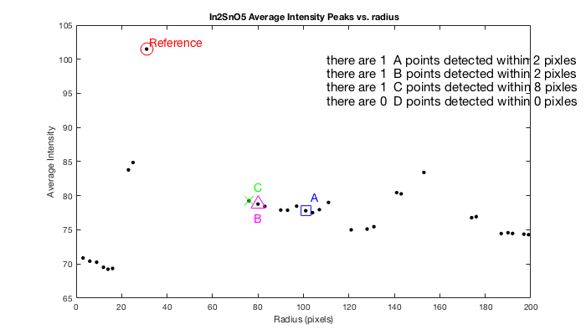
In₂SnO₅ 100% DATA
 | A | B | C | D
Expected Peak Locations for In2SnO5 Phase: | 99.74 | 78.67 | 68.63 | -
Experimental locations | 101 | 80 | 76 | -
# detected | 1 | 1 | 1 | -
% error | 1.26 | 1.69 | 10.74 | -
Notes:
Same problem as the previous slide

Slide 14
Results and conclusions
This experimental atomic structure might be In₄Sn3O₁₂ or In₂SnO₅.
In₄Sn3O₁₂ has more peak fittings even though peak D vanished.
In₂SnO₅ has the lowest deviation compared to expected locations from Crystal maker Simulation.
 | %Error
Peak Locations for In2O3 Phase: | 20.65
Peak Locations for In4Sn3O12 Phase: | 9.61
Peak Locations for In2SnO5 Phase: | 3.88

Slide 15
Q&a
What factors cause peak variation? Why does some peak vanish over time? Experiment noise or data processing method?
Is there any other possible atomic structure?
Magnitude of average intensity is helpful for curve fitting with crystal makers. Is it possible to stabilize the intensity and do some curve fitting? Or maybe more distinct expected location can be provided for analysis.

Slide 16
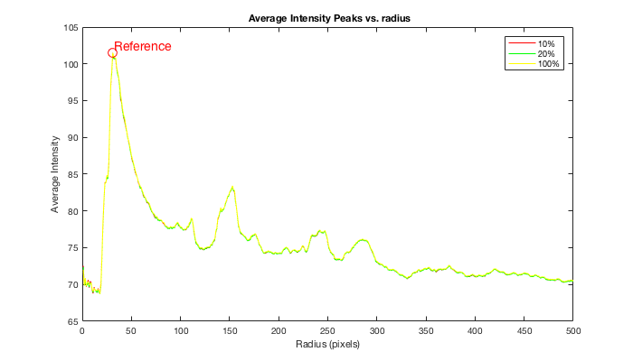
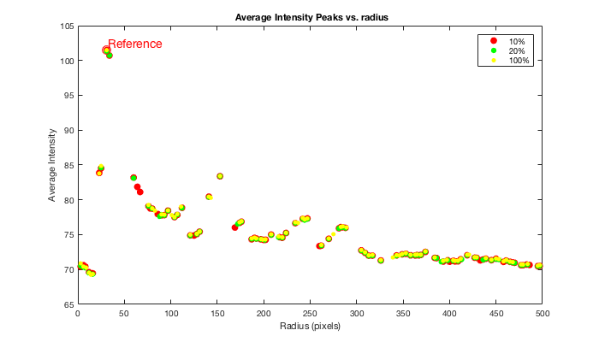
Backup slides

Slide 17
Input Highest (or Second Highest) Intensity Pixel Radii Here | 101.50
 | A | B | C | D
Expected Peak Locations for In2O3 Phase: | 71.77 | 58.60 | - | -
Detection range | 70~74 | 57~61
Expected Peak Locations for In4Sn3O12 Phase: | 100.42 | 79.70 | 76.09 | 62.64
Detection range | 98~102 | 78~82 | 74~78 | 61~65
Expected Peak Locations for In2SnO5 Phase: | 99.74 | 78.67 | 68.63 | -
Detection range | 98~102 | 77~81 | 67~71

